Slide 1

SQL project on healthcare industry by – vaibhav agrawal

Slide 2

Agenda
This SQL project aims to analyze healthcare data by identifying the month with the highest patient count, gender distribution, and patient age groups. It examines hospital metrics such as the longest stay, average stay by diagnosis, doctor performance, and patients treated by multiple doctors. The project also analyzes the highest treatment costs by disease and identifies the most common medical conditions across age groups.

Slide 3

SQL quries and their results

Slide 4
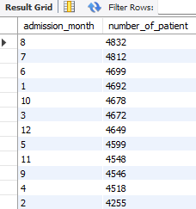
1. Month with highest no. of patients.

Slide 5


2. Count of male and female patients

Slide 6
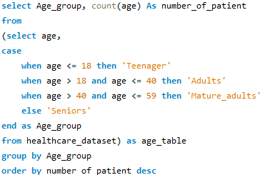
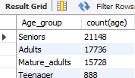
3. number of patient by the age group

Slide 7

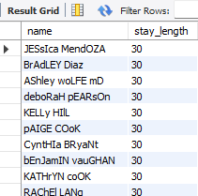
4. patient with the longest hospital stay.

Slide 8

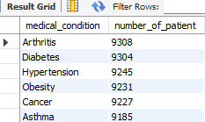
5. Number OF PATIENT FOR EACH MEDICAL CONDITION

Slide 9
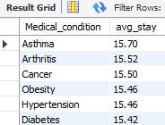
6. Avg. stay length as per diagnosis.

Slide 10

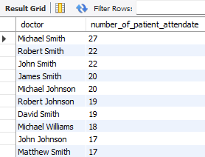
7. doctor performance analysis

Slide 11

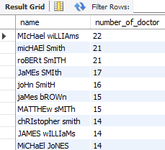
8. Patient who have attended by multiple doctors

Slide 12

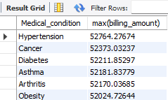
9. hieghest treatment cost by the patient on each Diseases

Slide 13


10. Disease with maximum number of patient

Slide 14
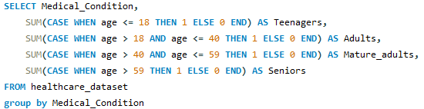
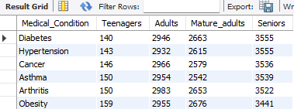
11. Medical condition as per different age group

Slide 15
outcome (from the perspective of hospital)
- The project enabled the accurate categorization of patients by age group, gender, and medical condition, simplifying the retrieval and analysis of patient demographics.
- SQL queries allowed for the automation of key tasks such as identifying the busiest months, tracking patients with long hospital stays, and monitoring average stay lengths, thus improving operational workflows.
- Performance analytics for doctors based on patient data were developed, helping hospital administrators allocate resources more effectively and identify areas for improvement in patient care.
- By analyzing treatment costs and patient outcomes, the hospital management can make better financial decisions and optimize treatments to reduce costs for both patients and the facility.

Slide 16
Outcome (from the perspective of SQl learning)
− Data Retrieval: Utilized SELECT to extract specific columns and rows
- Filtering: Applied WHERE clauses to target relevant records.
- Sorting: Ordered results using ORDER BY.
- Aggregation: Implemented functions like COUNT( ), SUM( ), and AVG( ) for data analysis.
- Grouping: Used GROUP BY to aggregate data into meaningful groups.
- Subqueries: Applied nested queries for complex data retrieval
- Functions: Leveraged built-in SQL functions like EXTRACT() for date operations, STR_TO_DATE() for converting strings to dates, and other functions for data manipulation.

Slide 17

Thank you
Vaibhav Agrawal

